Slide 1
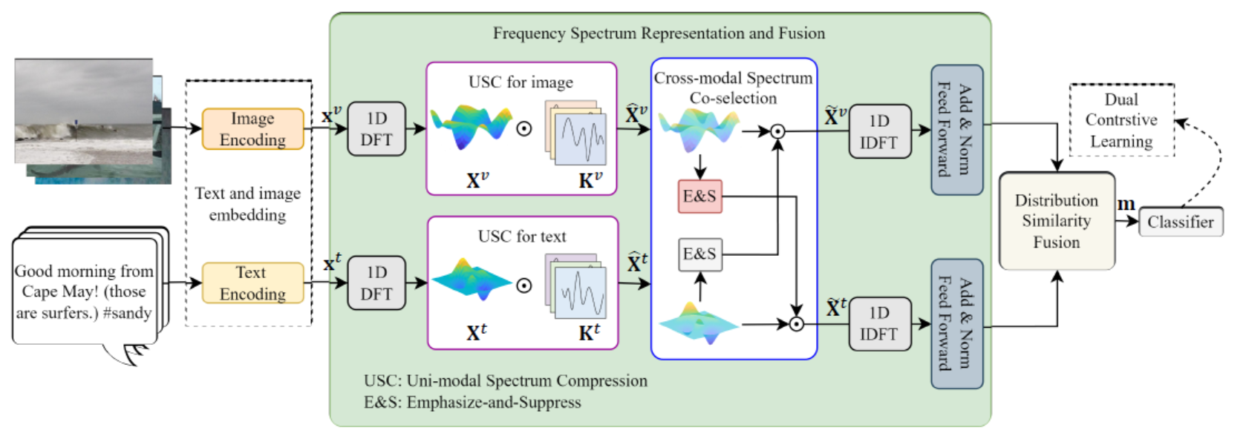
2024_AAAI_Frequency Spectrum Is More Effective for Multimodal Representation and Fusion: A Multimodal Spectrum Rumor Detector

Slide 2
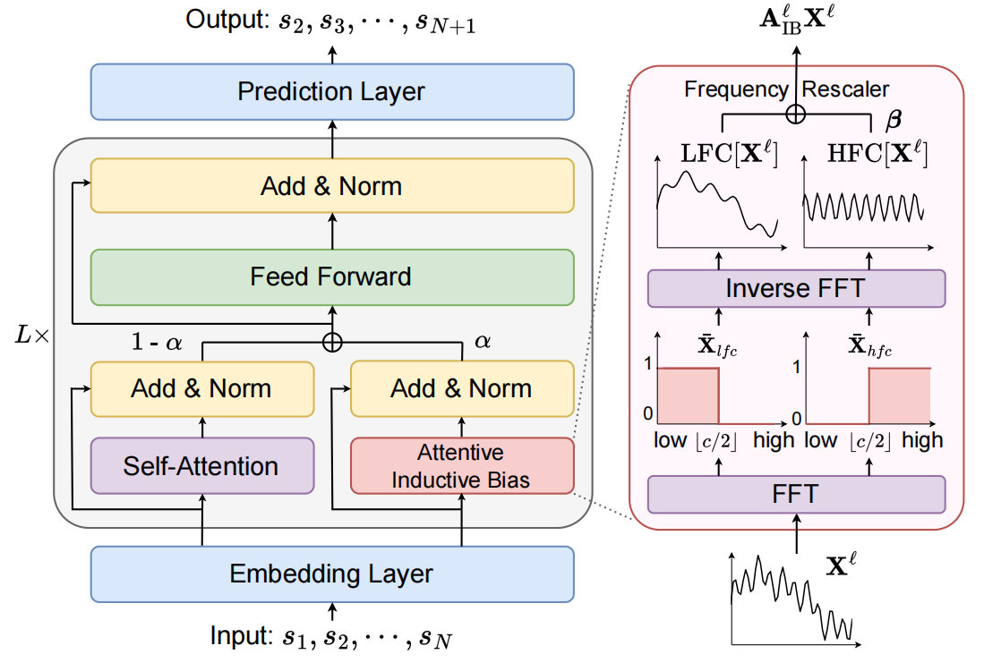
ATAI
Advanced Technique of Artificial Intelligence
Chongqing University ^{ATAI}
_{of Technology} Advanced Technique of
Artificial Intelligence
Chongqing University of Technology
2024_AAAI_An Attentive Inductive Bias for Sequential Recommendation beyond the Self-Attention

Slide 3
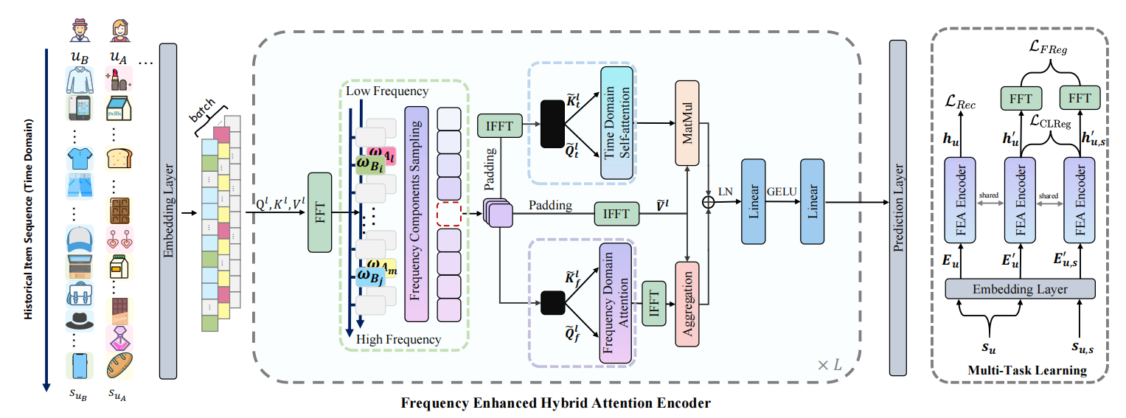
ATAI
Advanced Technique of Artificial Intelligence
Chongqing University ^{ATAI}
_{of Technology} Advanced Technique of
Artificial Intelligence
Chongqing University of Technology
2023_SIGIR_Frequency Enhanced Hybrid Attention Network for Sequential Recommendation

Slide 4
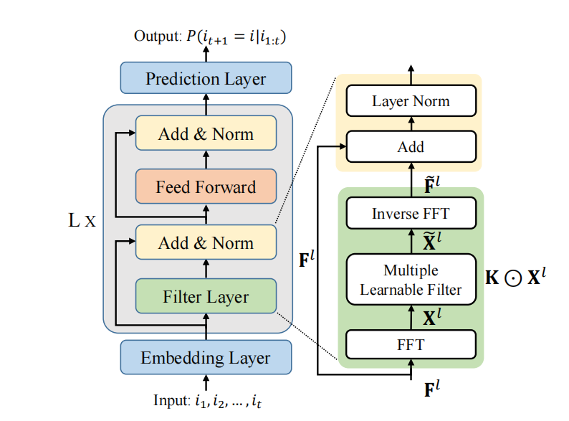
ATAI
Advanced Technique of Artificial Intelligence
Chongqing University ^{ATAI}
_{of Technology} Advanced Technique of
Artificial Intelligence
Chongqing University of Technology
2022_WWW_Filter-enhanced MLP is All You Need for Sequential Recommendation

Slide 5
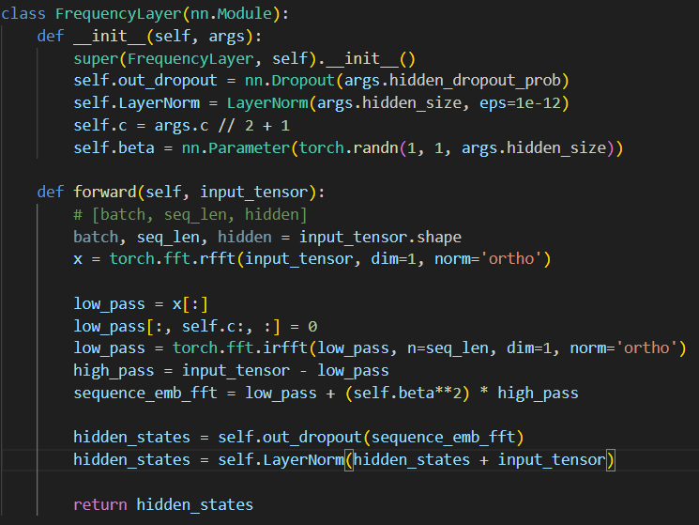
Chongqing University ^{ATAI}
_{of Technology} Advanced Technique of
Artificial Intelligence
Chongqing University of Technology
推荐系统——傅里叶变换代码（AAAI_2024）
输入:[batch_size,seq_len,hiden_size]
输出:[batch_size,seq_len,hiden_size]

